Slide 1

Impact of Yelp reviews on a restaurant’s business
Presented By
Ankit Anand
Hemanth Devavarapu
Shefali Jain
Rohit Kata

Slide 2
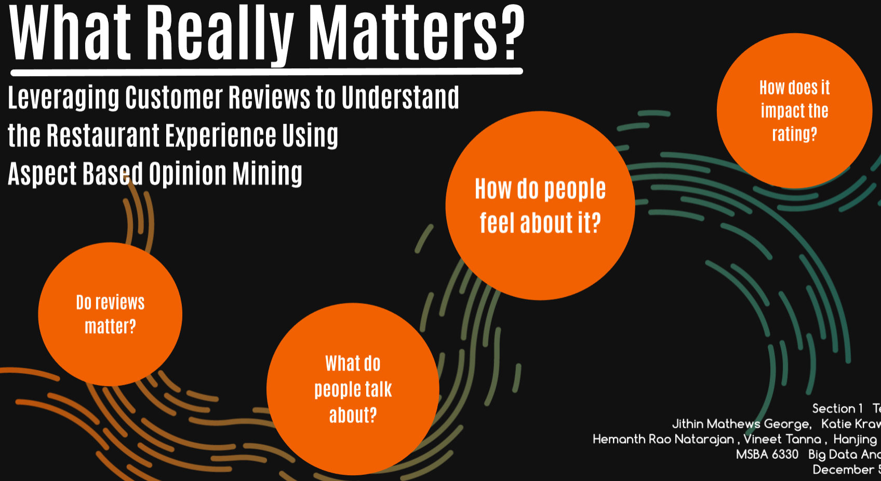

Slide 3
Hypothesis
To improve the rating of a restaurant, topics such as food quality, service, price and ambience are the most important criteria that matter to the customer satisfaction and are assumed to be significant

Slide 4
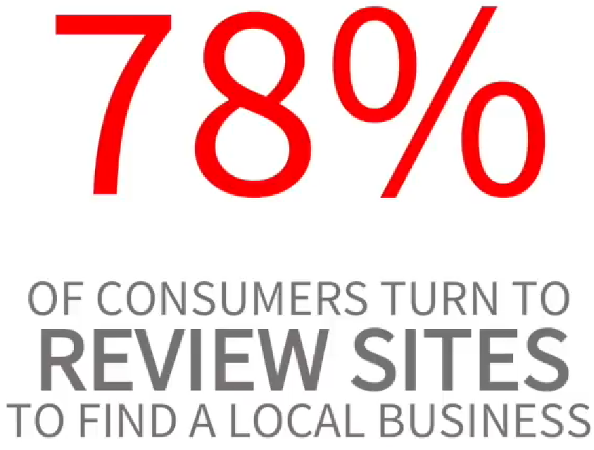
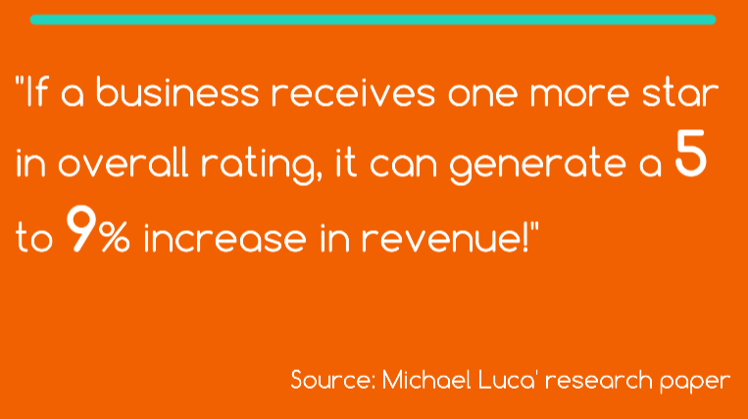
Do reviews matter?

Slide 5
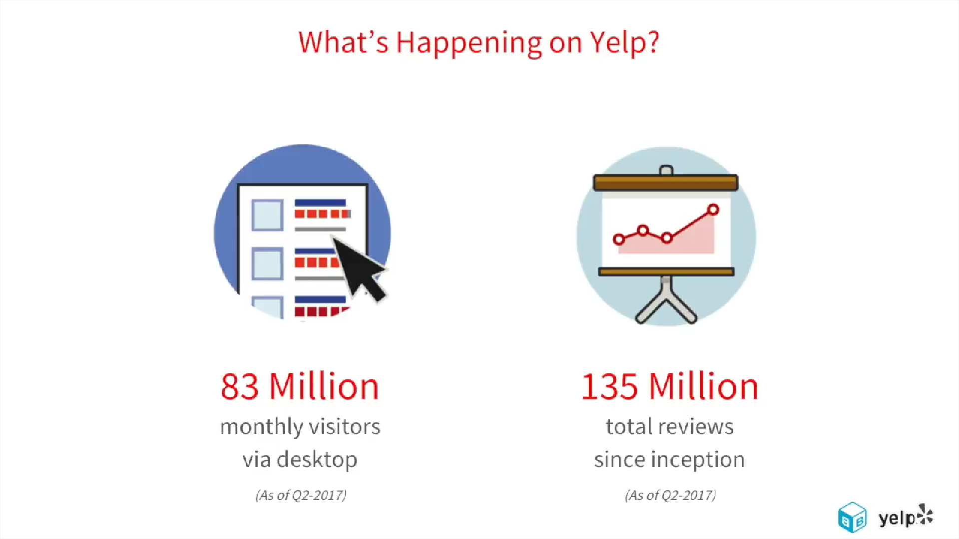
Yelp is important for restaurant business because it’s the leading consumer review site and has a huge user base

Slide 6
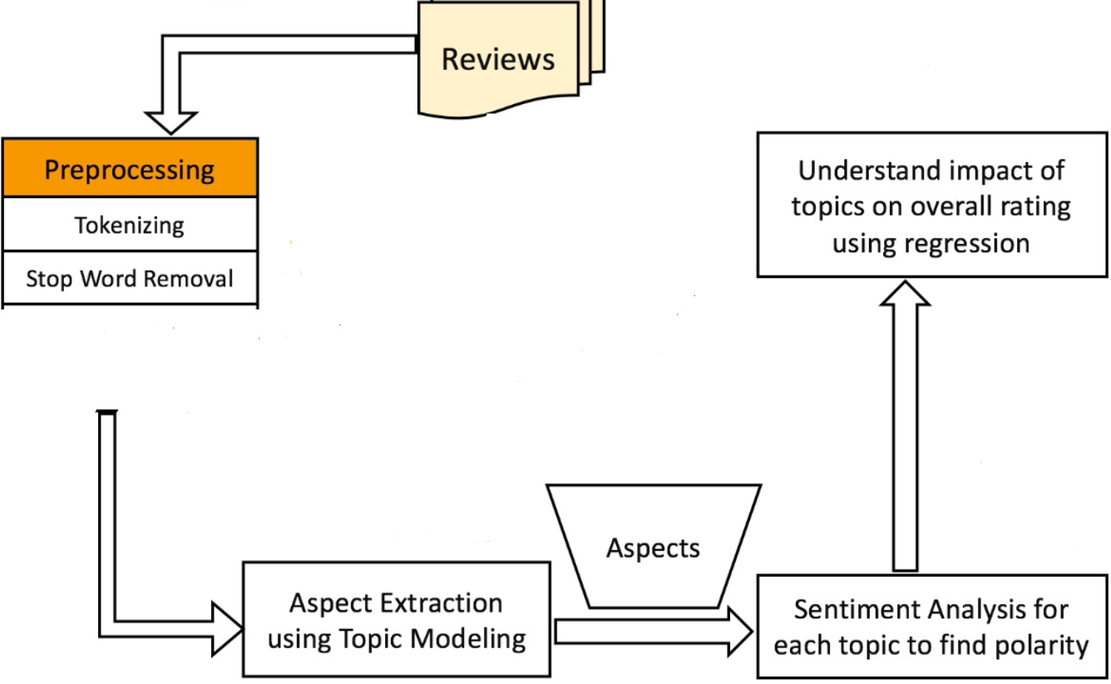
We followed a four step method to understand the impact of topics from the user reviews

Slide 7
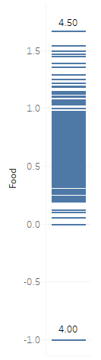
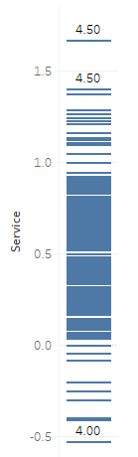
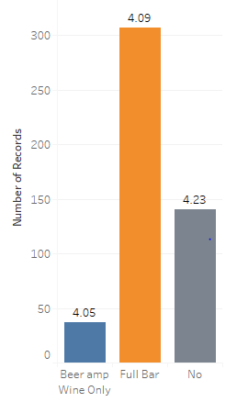
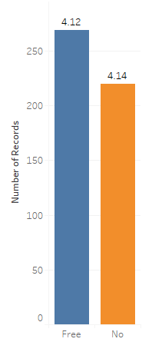
User preference is inclined positively towards restaurants which provides Wi-Fi and which do not serve alcohol
Average rating for restaurants that do not serve alcohol is higher than those that do
Average rating for restaurants that provide Wi-Fi is higher
Average rating increases with increase in polarity of food and service

Slide 8
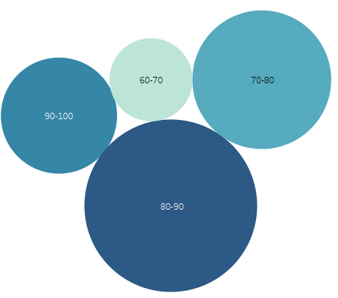
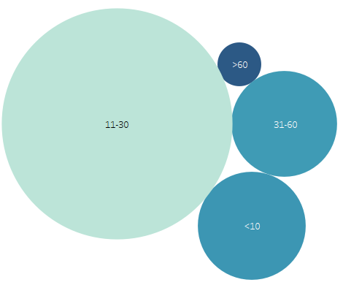
Initial analysis revealed that user prefer restaurants which have high health scores and which are in the price range of $11-$30
The average rating increases with increase in health score
The average rating increases with increase in price range i.e. expensive restaurants have a higher rating

Slide 9
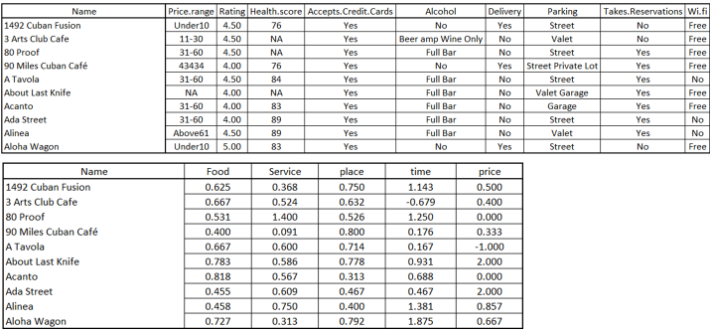
For a restaurant, we took a combination of topics and numerous business info as the input for the model
Restaurant name | Accepts Credit Cards | Wi Fi | Rating
Takes Reservations | Parking | URL Link | Health Score
Delivery | Alcohol | Price Range | Customer Reviews - Polarity

Slide 10
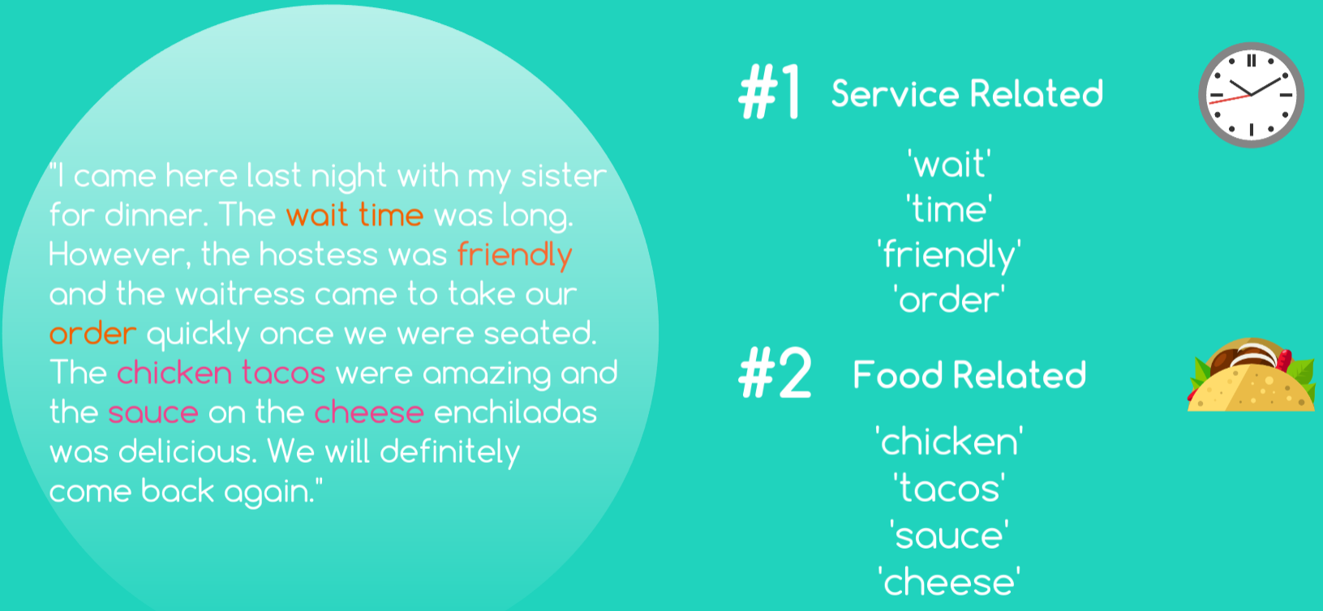
Topic Modeling on the user reviews was done to generate the topics for the statistical model

Slide 11
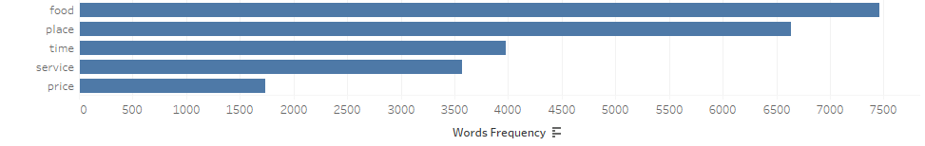
Results of topic modelling on the dataset revealed that ‘food’ and ‘place’ were the most significant topics
The above chart displays the top 5 topics obtained after topic modelling was done on the user reviews on Yelp.

Slide 12
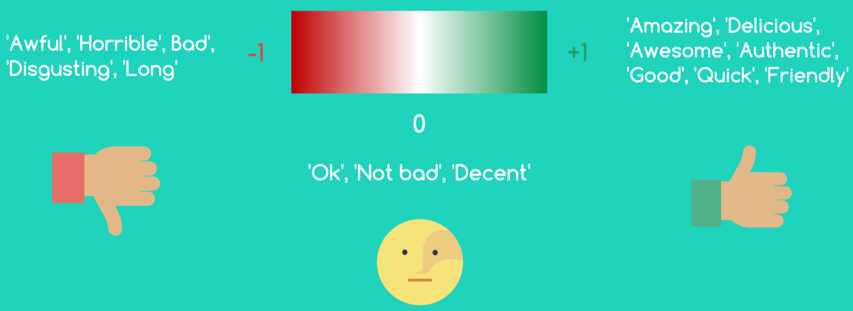
Polarity was calculated and was used as the input for the model to test the hypothesis
Overall Polarity Score =
( ∑ positive scores - ∑ negative scores) * Frequency of topic in reviews
Total number of reviews

Slide 13
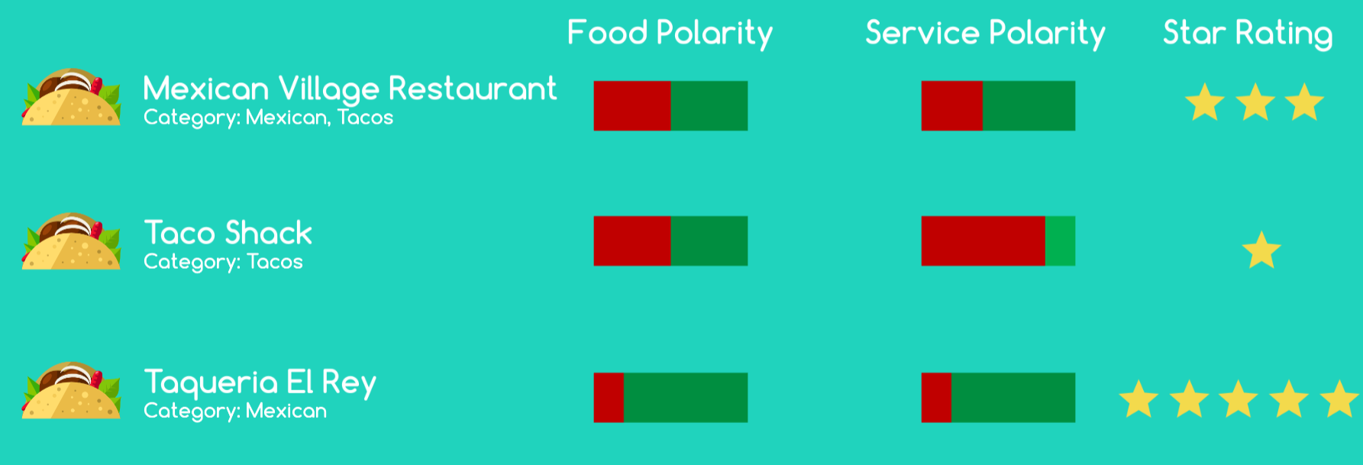
Polarity affected the restaurants’ Yelp rating

Slide 14
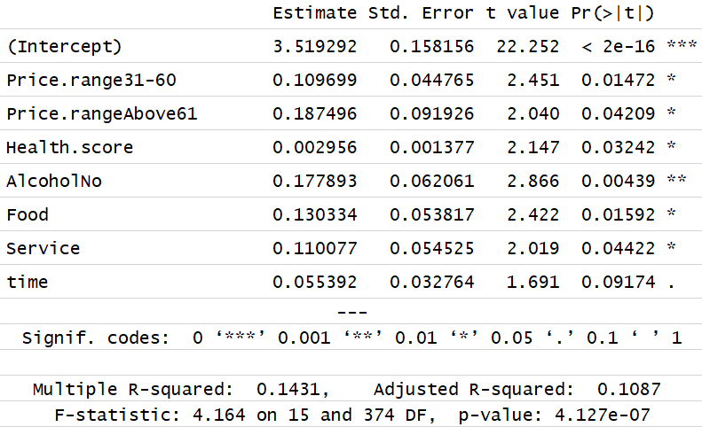

Effect of topics and categories on Rating

Slide 15
Effect of topics and categories on Rating
Restaurant with higher price range tend to have higher rating
Restaurant with higher health score have higher rating
Restaurant which do not serve alcohol tend to have higher rating
Restaurant with positive food polarity tend to have higher rating
Restaurant with positive service polarity tend to have higher rating

Slide 16
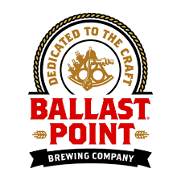
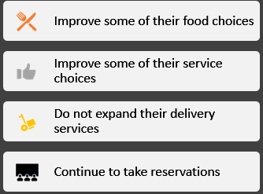
How does Ballast Point benefit?
Current situation
Recommendations based on our model
Food polarity: 0.285
Service: 0.36
Place: 0.8
Price: 0.25
Rating: 3.5

Slide 17
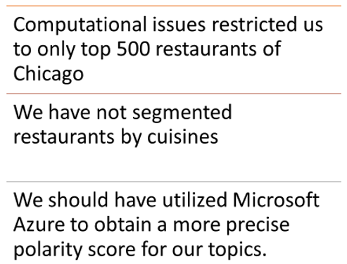
Few limitations of our approach and model

Slide 18
Thank you!

